Slide 1
Introduction to DevOps
Sonika Rathi
Assistant Professor
BITS Pilani

Slide 2
Agenda
Agile Methodologies
Test Driven Development
Feature Driven Development
Behavior Driven Development

Slide 3
TDD
TDD Introduction
Kent Beck said “Test-first code tends to be more cohesive and less coupled than code in which testing isn’t a part of the intimate coding cycle”
“If you can’t write a test for what you are about to code, then you shouldn’t even be thinking about coding”

Slide 4
TDD
TDD Three steps
RED
Write a new TEST which fails
GREEN
Write simplest possible code to make it succeed
REFACTOR
Refactor the code (including test code)

Slide 5
TDD
TDD Technique
TDD is a technique whereby you write your test cases before you write any implementation code

Slide 6
TDD
TDD Overview
Write a test
Compile
Run test, watch it fail
Write code
Fix Compile error
Run test watch it pass
Refactor the code

Slide 7
TDD
TDD Overview Contd..
How It Works:
Add a Test
Use Cases / User Stories are used to understand the requirement clearly
Run all tests and see the new one fail
Ensures test harness is working correctly
Ensures that test does not mistakenly pass
Write some code
Only code that is designed to pass the test
No additional functionality should be included because it will be untested
Run the automated tests and see them succeed
If tests pass, programmer can be confident code meets all tested requirements
Refactor code
Cleanup the code
Rerun tests to ensure cleanup did not break anything
Repeat

Slide 8
TDD
TDD Overview Contd..
In Extreme Programming Explored (The Green Book), Bill Wake describes the test / code cycle:
Write a single test
Compile it. It shouldn’t compile because you’ve not written the implementation code
Implement just enough code to get the test to compile
Run the test and see it fail
Implement just enough code to get the test to pass
Run the test and see it pass
Refactor for clarity and “once and only once”
Repeat

Slide 9
TDD
Why TDD
TDD can lead to more modularized, flexible, and extensible code
Clean code
Leads to better design
Better code documentation
More productive

Slide 10
TDD
Test First vs. Test Last
User Story
User Story
Understand
Understand
Add a test case
Implementation
Write code
Write the tests for story
Run all tests
Run all tests
Rework
Rework
Result?
P
Result?
P
F
No
F
Story completed?
Next story
Yes
Next story

Slide 11
Feature Driven Development
FDD History
Original Creator: Jeff De Luca
Singapore in late 1997
FDD evolved from an actual project
Bank Loan Automation
Luca was Project manager
50 member developer team
Peter Coad : Chief Architect
1990’s object-oriented analysis and design expert

Slide 12
FDD
What is a Feature?
Definition: small function expressed in client-valued terms
FDD’s form of a customer requirement

Slide 13
FDD
FDD Primary Roles
Project Manager
Chief Architect
Development Manager
Domain Experts
Class Owners
This concept differs FDD over XP
Benefits
Someone responsible for integrity of each class
Each class will have an expert available
Class owners can make changes much quicker, if needed anytime
Easily lends to notion of code ownership
Assists in FDD scaling to larger teams, as we have one person available for complete ownership of feature.
Chief Programmers

Slide 14
FDD
FDD Supporting Roles
Release Manager
Language Guru
Build Engineer
Toolsmith
System Administrator
Tester
Deployers
Technical Writer

Slide 15
FDD
Feature Driven Development Process
Process #1: Develop an Overall Model
Process #2: Build a Features List
Process #3: Plan By Feature
Constructing the initial schedule, Forming level of individual features, Prioritizing by business value , As we work on above factors we do consider dependencies, difficulty, and risks.
These factors will help us on Assigning responsibilities to team members, Determining Class Owners , Assigning feature sets to chief programmers
Process #4: Design By Feature
Goal: not to design the system in its entirety but instead is to do just enough initial design that you are able to build on
This is more about Form Feature Teams: Where team members collaborate on the full low level analysis and design.
Process #5: Build By Feature
Goal: Deliver real, completed, client-valued function as often as possible

Slide 16
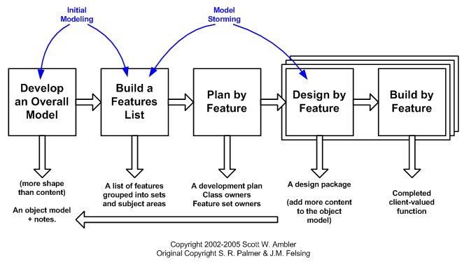
FDD
Feature Driven Development Process Contd..

Slide 17
Behavior Driven Development
BDD Introduction
Behavior-Driven Development (BDD) is a software development process
BDD is considered an effective technical practice especially when the "problem space" for the business is complex
What is BDD?:
General Technique of TDD
Follows same principle as TDD
Shared tools
Shared Process

Slide 18
BDD
BDD Focus
Where to start in the process
What to test and what not to test
How much to test in one go
What to call the tests
How to understand why a test fails
Write failing unit test
Refactor the code
Write failing acceptance test
Write failing unit test
Refactor the code
BDD
TDD

Slide 19
BDD
BDD Basic structure
BDD consists of cycles of a set of steps to follow.
Identify business feature
Identify scenarios under the selected feature
Define steps for each scenario
Run feature and fail
Write code to make steps pass
Refactor code, Create reusable automation library
Run feature and pass
Generate test reports

Slide 20
BDD
BDD Example
User story:
As someone interested in using the Mobile app, and want to sign up in app to enjoy app membership
Mobile App Signup:
Scenario 1:
Given that I am on the app's "Create new account" screen
Then I should see a "Sign up using Facebook" button
And I should see a "Sign up using Twitter" button
And I should see a "Sign up with email" form field
Then I should see a new screen that asks permission to use my Facebook account data to create my new Mobile app account

Slide 21
BDD
BDD Sign Use
Functional Documentation in terms of User Stories & Executable Scenarios
Instead of referring to "tests", a BDD practitioner will prefer the terms "scenario" and "specification"
Rather than refer to "functional tests", the preferred term will be "specifications of the product's behavior"
Specification Names are more expressive

Slide 22
References
http://agilemodeling.com/

Slide 23
Thank You!
In our next session:

